Slide 1
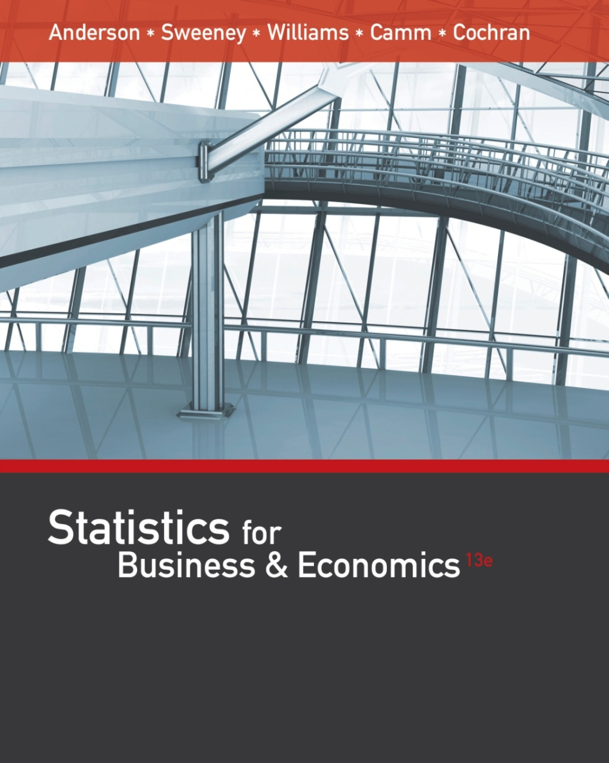
Chapter 2
Descriptive Statistics: Tabular and Graphical Displays

Slide 2
Part A - Descriptive Statistics: Tabular and Graphical Displays
Summarizing Data for a Categorical Variable
Categorical data use labels or names to identify categories of like items.
Summarizing Data for a Quantitative Variable
Quantitative data are numerical values that indicate how much or how many.

Slide 3
Summarizing Categorical Data
Frequency Distribution
Relative Frequency Distribution
Percent Frequency Distribution
Bar Chart
Pie Chart

Slide 4
Frequency Distribution
A frequency distribution is a tabular summary of data showing the number (frequency) of observations in each of several non-overlapping categories or classes.
The objective is to provide insights about the data that cannot be quickly obtained by looking only at the original data.

Slide 5
Frequency Distribution
Example: Marada Inn
Guests staying at Marada Inn were asked to rate the quality of their accommodations as being excellent, above average, average, below average, or poor.
The ratings provided by a sample of 20 guests are:
Below Average | Average | Above Average
Above Average | Above Average | Above Average
Above Average | Below Average | Below Average
Average | Poor | Poor
Above Average | Excellent | Above Average
Average | Above Average | Average
Above Average | Average

Slide 6
Frequency Distribution
Example: Marada Inn
Rating | Frequency
Poor | 2
Below Average | 3
Average | 5
Above Average | 9
Excellent | 1
Total | 20

Slide 7
Relative Frequency Distribution
The relative frequency of a class is the fraction or proportion of observations belonging to the class to the total number of data items (n).
A relative frequency distribution is a tabular summary of data showing the relative frequency for each class.
$Relative frequency of a class$ = $\frac{Frequency of the class}{n}$

Slide 8
Percent Frequency Distribution
The percent frequency of a class is the relative frequency multiplied by 100.
A percent frequency distribution is a tabular summary of a set of data showing the percent frequency for each class.

Slide 9
Relative Frequency and Percent Frequency Distributions
Example: Marada Inn
Rating | Relative Frequency | Percent Frequency
Poor | .10 | 10
Below Average | .15 | 15
Average | .25 | 25
Above Average | .45 | 45
Excellent | .05 | 5
Total | 1.00 | 100

Slide 10
Bar Chart
A bar chart is a graphical display for depicting qualitative data.
On one axis (usually the horizontal axis), we specify the labels that are used for each of the classes.
A frequency, relative frequency, or percent frequency scale can be used for the other axis (usually the vertical axis).
Using a bar of fixed width drawn above each class label, we extend the height appropriately.
The bars are separated to emphasize the fact that each class is a separate category.

Slide 11
Bar Chart
Marada Inn Quality Ratings
10
9
8
7
6
Frequency
5
4
3
2
1
Quality
Rating
Poor
Below
Average
Average
Above
Average
Excellent

Slide 12
Pareto Diagram
In quality control, bar charts are used to identify the most important causes of problems.
When the bars are arranged in descending order of height from left to right (with the most frequently occurring cause appearing first) the bar chart is called a Pareto diagram.
This diagram is named for its founder, Vilfredo Pareto, an Italian economist.

Slide 13
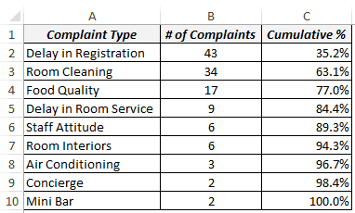
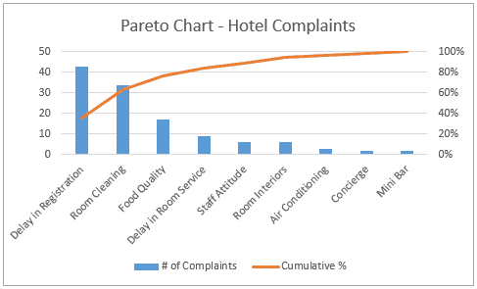
Pareto Diagram - Example

Slide 14
Pie Chart
The pie chart is a commonly used graphical display for presenting relative frequency and percent frequency distributions for categorical data.
First draw a circle; then use the relative frequencies to subdivide the circle into sectors that correspond to the relative frequency for each class.
Since there are 360 degrees in a circle, a class with a relative frequency of .25 would consume .25(360) = 90 degrees of the circle.

Slide 15
Pie Chart
Marada Inn Quality Ratings
Excellent
5%
Poor
10%
Below
Average
15%
Above
Average
45%
Average
25%
Average
25%

Slide 16
Summarizing Quantitative Data
Frequency Distribution
Relative Frequency and Percent Frequency Distributions
Histogram
Cumulative Distributions
Stem-and-Leaf Display

Slide 17
Frequency Distribution
Example: Hudson Auto Repair
The manager of Hudson Auto would like to gain a better understanding of the cost of parts used in the engine tune-ups performed in the shop. She examines 50 customer invoices for tune-ups. The costs of parts, rounded to the nearest dollar, are listed on the next slide.

Slide 18
Frequency Distribution
Example: Hudson Auto Repair
Sample of Parts Cost($) for 50 Tune-ups
91
78
93
57
75
52
99
80
97
62
71
69
72
89
66
75
79
75
72
76
104
74
62
68
97
105
77
65
80
109
85
97
88
68
83
68
71
69
67
74
62
82
98
101
79
105
79
69
62
73

Slide 19
Frequency Distribution
The three steps necessary to define the classes for a frequency distribution with quantitative data are:
1. Determine the number of non-overlapping classes.
2. Determine the width of each class.
3. Determine the class limits.

Slide 20
Frequency Distribution
Guidelines for Determining the Number of Classes
Use between 5 and 20 classes.
Data sets with a larger number of elements usually require a larger number of classes.
Smaller data sets usually require fewer classes.
The goal is to use enough classes to show the variation in the data, but not so many classes that some contain only a few data items.
If k represents the number of classes and N the total number of observations, then the value of k will be the smallest exponent of the number 2, so that 2^{k} ≥ N.

Slide 21
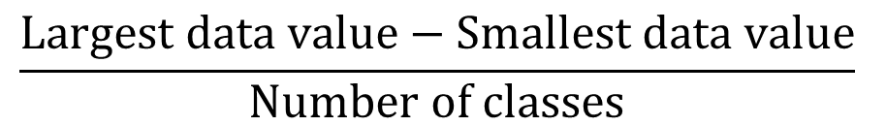
Frequency Distribution
Guidelines for Determining the Width of Each Class
Use classes of equal width.
Approximate Class Width =
$$\frac{Largest data value−Smallest data value}{Number of classes}$$
Making the classes the same width reduces the chance of inappropriate interpretations.

Slide 22
Frequency Distribution
Note on Number of Classes and Class Width
In practice, the number of classes and the appropriate class width are determined by trial and error.
Once a possible number of classes is chosen, the appropriate class width is found.
The process can be repeated for a different number of classes.
Ultimately, the analyst uses judgment to determine the combination of the number of classes and class width that provides the best frequency distribution for summarizing the data.

Slide 23
Frequency Distribution
Guidelines for Determining the Class Limits
Class limits must be chosen so that each data item belongs to one and only one class.
The lower class limit identifies the smallest possible data value assigned to the class.
The upper class limit identifies the largest possible data value assigned to the class.
The appropriate values for the class limits depend on the level of accuracy of the data.
An open-end class requires only a lower class limit or an upper class limit.

Slide 24
Frequency Distribution
Class Midpoint
In some cases, we want to know the midpoints of the classes in a frequency distribution for quantitative data.
The class midpoint is the value halfway between the lower and upper class limits.

Slide 25
Frequency Distribution
Example: Hudson Auto Repair
If we choose six classes (2⁶ > 50):
Approximate Class Width = (109 - 50)/6 = 9.83≅ 10
50-59
60-69
70-79
80-89
90-99
100-109
2
13
16
7
7
5
Total 50
Parts Cost ($)
Frequency

Slide 26
Relative Frequency and Percent Frequency Distributions
Example: Hudson Auto Repair
Parts
Cost ($)
Relative
Frequency
Percent
Frequency
50-59
60-69
70-79
80-89
90-99
100-109
.04 = 2/50
.26
.32
.14
.14
.10
Total 1.00
4 = .04(100)
26
32
14
14
10
100

Slide 27
Relative Frequency and Percent Frequency Distributions
Example: Hudson Auto Repair
Insights Gained from the Percent Frequency Distribution:
Only 4% of the parts costs are in the $50-59 class.
30% of the parts costs are under $70.
The greatest percentage (32% or almost one-third) of the parts costs are in the $70-79 class.
10% of the parts costs are $100 or more.

Slide 28
Histogram
A common graphical display of quantitative data is a histogram.
The variable of interest is placed on the horizontal axis.
A rectangle is drawn above each class interval with its height corresponding to the interval’s frequency, relative frequency, or percent frequency.
Unlike a bar graph, a histogram has no natural separation between rectangles of adjacent classes.

Slide 29
Histogram
Example: Hudson Auto Repair
18
Tune-up Parts Cost
16
14
12
10
Frequency
8
6
4
2
Parts
Cost ($)
50-59 60-69 70-79 80-89 90-99 100-110

Slide 30
Histograms Showing Skewness
Symmetric
Left tail is the mirror image of the right tail
Example: Heights of People
.35
.30
.25
.20
Relative Frequency
.15
.10
.05
0

Slide 31
Histograms Showing Skewness
Moderately Skewed Left
A longer tail to the left
Example: Exam Scores
.35
.30
.25
.20
Relative Frequency
.15
.10
.05
0

Slide 32
Histograms Showing Skewness
Moderately Right Skewed
A Longer tail to the right
Example: Housing Values
.35
.30
.25
.20
Relative Frequency
.15
.10
.05
0

Slide 33
Histograms Showing Skewness
Highly Skewed Right
A very long tail to the right
Example: Executive Salaries
.35
.30
.25
.20
Relative Frequency
.15
.10
.05
0

Slide 34
Cumulative Distributions
Cumulative frequency distribution - shows the number of items with values less than or equal to the upper limit of each class.
Cumulative relative frequency distribution – shows the proportion of items with values less than or equal to the upper limit of each class.
Cumulative percent frequency distribution – shows the percentage of items with values less than or equal to the upper limit of each class.

Slide 35
Cumulative Distributions
The last entry in a cumulative frequency distribution always equals the total number of observations.
The last entry in a cumulative relative frequency distribution always equals 1.00.
The last entry in a cumulative percent frequency distribution always equals 100.

Slide 36
Cumulative Distributions
Hudson Auto Repair
Cumulative
Relative
Frequency
Cumulative
Percent
Frequency
Cumulative
Frequency
< 59
< 69
< 79
< 89
< 99
< 109
Cost ($)
2
15 = 2+13
31
38
45
50
.04
.30 = 15/50
.62
.76
.90
1.00
4
30 = .30(100)
62
76
90
100

Slide 37
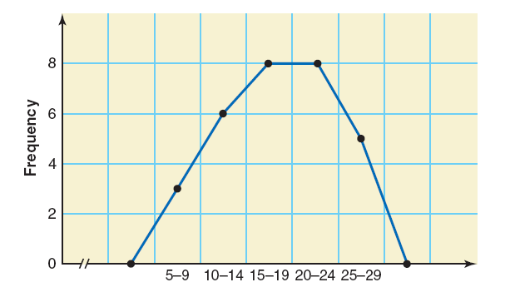
Frequency Polygon
A graph formed by joining the midpoints of the tops of successive bars in a histogram with straight lines is called a frequency polygon.

Slide 38
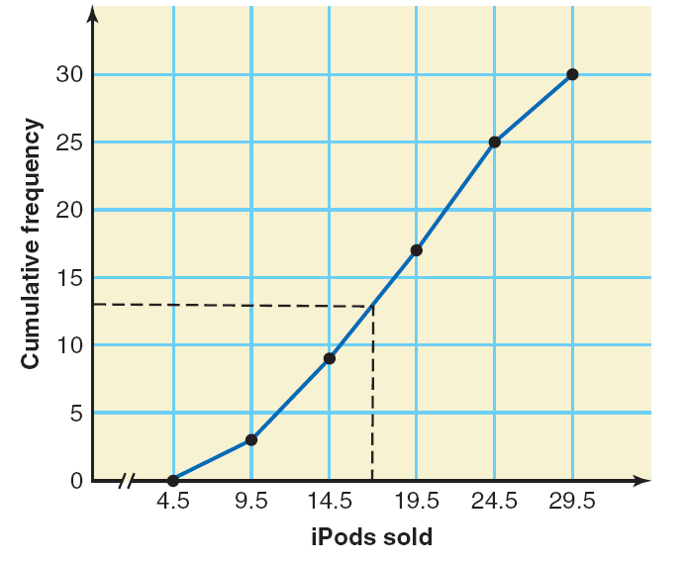
Ogive
An ogive is a curve drawn for the cumulative frequency distribution by joining with straight lines the dots marked above the upper boundaries of classes at heights equal to the cumulative frequencies of respective classes.

Slide 39
Part B - Descriptive Statistics: Tabular and Graphical Displays
Summarizing Data for Two Variables Using Tables
Summarizing Data for Two Variables Using Graphical Displays
Data Visualization: Best Practices in Creating Effective Graphical Displays

Slide 40
Summarizing Data for Two Variables using Tables
Thus far we have focused on methods that are used to summarize the data for one variable at a time.
Often a manager is interested in tabular and graphical methods that will help understand the relationship between two variables.
Crosstabulation is a method for summarizing the data for two variables.

Slide 41
Crosstabulation
A crosstabulation is a tabular summary of data for two variables.
Crosstabulation can be used when:
one variable is categorical and the other is quantitative,
both variables are categorical, or
both variables are quantitative.
The left and top margin labels define the classes for the two variables.

Slide 42
Crosstabulation
Example: Finger Lakes Homes
The number of Finger Lakes homes sold for each style and price for the past two years is shown below.
Price
Range
Home Style
Colonial Log Split A-Frame
Total
18 6 19 12
< $250,000
> $250,000
55
45
12 14 16 3
Total
30 20 35 15
100

Slide 43
Crosstabulation
Example: Finger Lakes Homes
Insights Gained from Preceding Crosstabulation
The greatest number of homes (19) in the sample are a split-level style and priced at less than $250,000.
Only three homes in the sample are an A-Frame style and priced at $250,000 or more.

Slide 44
Crosstabulation: Row or Column Percentages
Converting the entries in the table into row percentages or column percentages can provide additional insight about the relationship between the two variables.

Slide 45
Crosstabulation: Row Percentages
Example: Finger Lakes Homes
Price
Range
Home Style
Colonial Log Split A-Frame
Total
32.73 10.91 34.55 21.82
< $250,000
> $250,000
100
100
26.67 31.11 35.56 6.67
Note: row totals are actually 100.01 due to rounding.
(Colonial and > $250K)/(All > $250K) x 100 = (12/45) x 100

Slide 46
Crosstabulation: Column Percentages
Example: Finger Lakes Homes
Price
Range
Home Style
Colonial Log Split A-Frame
< $250,000
> $250,000
60.00 30.00 54.29 80.00
40.00 70.00 45.71 20.00
Total
100 100 100 100
(Colonial and > $250K)/(All Colonial) x 100 = (12/30) x 100

Slide 47
Summarizing Data for Two Variables
Using Graphical Displays
In most cases, a graphical display is more useful than a table for recognizing patterns and trends.
Displaying data in creative ways can lead to powerful insights.
Scatter diagrams and trendlines are useful in exploring the relationship between two variables.

Slide 48
Scatter Diagram and Trendline
A scatter diagram is a graphical presentation of the relationship between two quantitative variables.
One variable is shown on the horizontal axis and the other variable is shown on the vertical axis.
The general pattern of the plotted points suggests the overall relationship between the variables.
A trendline provides an approximation of the relationship.

Slide 49
Scatter Diagram
A Positive Relationship
y
x

Slide 50
Scatter Diagram
A Negative Relationship
y
x

Slide 51
Scatter Diagram
No Apparent Relationship
y
x

Slide 52
Scatter Diagram
Example: Panthers Football Team
The Panthers football team is interested in investigating the relationship, if any, between interceptions made and points scored.
x = Number of
Interceptions
y = Number of
Points Scored
1
3
2
1
3
14
24
18
17
30

Slide 53
Scatter Diagram and Trendline
y
35
30
25
20
Number of Points Scored
15
10
5
0
x
0
1
2
3
4
Number of Interceptions

Slide 54
Example: Panthers Football Team
Insights Gained from the preceding Scatter Diagram
The scatter diagram indicates a positive relationship between the number of interceptions and the number of points scored.
Higher points scored are associated with a higher number of interceptions.
The relationship is not perfect; all plotted points in the scatter diagram are not on a straight line.

Slide 55
Side-by-Side Bar Chart
A side-by-side bar chart is a graphical display for depicting multiple bar charts on the same display.
Each cluster of bars represents one value of the first variable.
Each bar within a cluster represents one value of the second variable.

Slide 56
Side-by-Side Bar Chart
Finger Lake Homes
20
18
16
< $250,000
> $250,000
14
12
Frequency
10
8
6
4
2
Home Style
Colonial
Log
Split-Level
A-Frame

Slide 57
Stacked Bar Chart
A stacked bar chart is another way to display and compare two variables on the same display.
It is a bar chart in which each bar is broken into rectangular segments of a different color.
If percentage frequencies are displayed, all bars will be of the same height (or length), extending to the 100% mark.

Slide 58
Stacked Bar Chart
Finger Lake Homes
40
36
32
28
< $250,000
24
> $250,000
Frequency
20
16
12
8
4
Home Style
Colonial
Log
Split
A-Frame

Slide 59
Stacked Bar Chart
Finger Lake Homes
100
90
80
70
60
< $250,000
Percentage Frequency
> $250,000
50
40
30
20
10
Home Style
Colonial
Log
Split
A-Frame

Slide 60
Data Visualization: Best Practices
in Creating Effective Graphical Displays
Data visualization is the use of graphical displays to summarize and present information about a data set.
The goal is to communicate as effectively and clearly as possible, the key information about the data.

Slide 61
Creating Effective Graphical Displays
Creating effective graphical displays is as much art as it is science.
Here are some guidelines . . .
Give the display a clear and concise title.
Keep the display simple.
Clearly label each axis and provide the units of measure.
If colors are used, make sure they are distinct.
If multiple colors or line types are used, provide a legend.

Slide 62
Choosing the Type of Graphical Display
Displays used to show the distribution of data:
Bar Chart to show the frequency distribution and relative frequency distribution for categorical data
Pie Chart to show the relative frequency and percent frequency for categorical data
Histogram to show the frequency distribution for quantitative data over a set of class intervals
Stem-and-Leaf Display to show both the rank order and shape of the distribution for quantitative data

Slide 63
Choosing the Type of Graphical Display
Displays used to make comparisons:
Side-by-Side Bar Chart to compare two variables
Stacked Bar Chart to compare the relative frequency or percent frequency of two categorical variables
Displays used to show relationships:
Scatter Diagram to show the relationship between two quantitative variables
Trendline to approximate the relationship of data in a scatter diagram

Slide 64
Data Dashboards
A data dashboard is a widely used data visualization tool.
It organizes and presents key performance indicators (KPIs) used to monitor an organization or process.
It provides timely summary information that is easy to read, understand, and interpret.
Some additional guidelines include . . .
Minimize the need for screen scrolling.
Avoid unnecessary use of color or 3D displays.
Use borders between charts to improve readability.

Slide 65
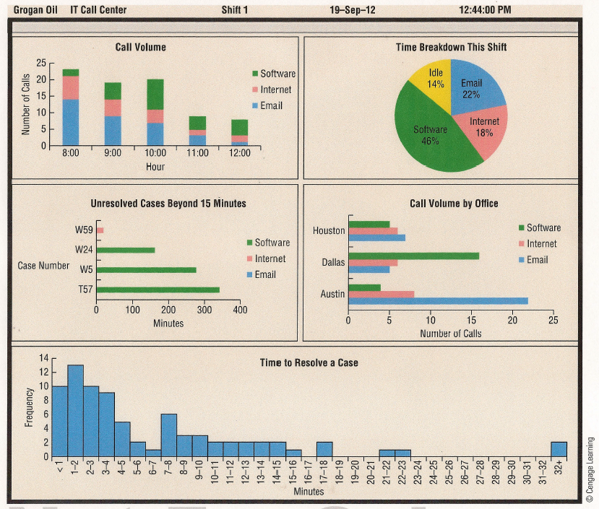
Data Dashboard Example

Slide 66
Tabular and Graphical Displays
Data
Categorical Data
Quantitative Data
Tabular
Displays
Graphical
Displays
Tabular
Displays
Graphical
Displays
Frequency
Distribution
Rel. Freq. Dist.
Percent Freq.
Distribution
Crosstabulation
Frequency Dist.
Rel. Freq. Dist.
% Freq. Dist.
Cum. Freq. Dist.
Cum. Rel. Freq. Dist.
Cum. % Freq. Dist.
Crosstabulation
Histogram
Polygon / Ogive
Stem-and-
Leaf Display
Scatter
Diagram
Bar Chart
Pie Chart
Side-by-Side
Bar Chart
Stacked
Bar Chart

Slide 67
End of Chapter 2

